Slide 1
Deep Learning for Automated Segmentation in MRI Scans
Nittin Murthi Dhekshinamoorthy

Slide 2
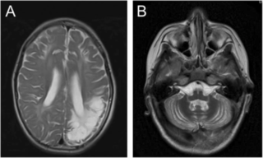
Background on MRI scans
Importance of Vascular Segmentation in Medical Image Analysis:
Blood vessels are vital conduits for supplying oxygen and nutrients to the brain.
Accurate segmentation of these vessels is pivotal for diagnosing a spectrum of neurological conditions.
Significance of Deep Learning:
Deep learning offers a transformative approach to automate vascular segmentation.
Compared to traditional manual methods, deep learning promises enhanced efficiency and accuracy.
Automation through deep learning holds the potential to revolutionize medical image analysis, facilitating quicker diagnoses and better patient outcomes.

Slide 3
Objectives
Research Objective:
Utilize deep learning models to automate the segmentation of blood vessels in brain MRI scans.
Importance of Vascular Segmentation:
Vascular segmentation is pivotal in medical image analysis as it facilitates the precise diagnosis of various neurological conditions. By accurately identifying vascular abnormalities, clinicians can better understand the underlying pathology and tailor treatment strategies accordingly.
Role of Deep Learning:
Traditional segmentation methods are labor-intensive and prone to human error. However, with the emergence of deep learning, there's a significant opportunity to revolutionize this process. Deep learning algorithms can be trained to recognize complex patterns and features in MRI scans, leading to more efficient and accurate segmentation results.
Significance:
By harnessing the power of deep learning, we aim to streamline the vascular segmentation process in brain MRI scans. This automation not only saves time and resources but also enhances diagnostic capabilities, ultimately improving patient care outcomes.

Slide 4
List of Deep Learning Models Used

Slide 5
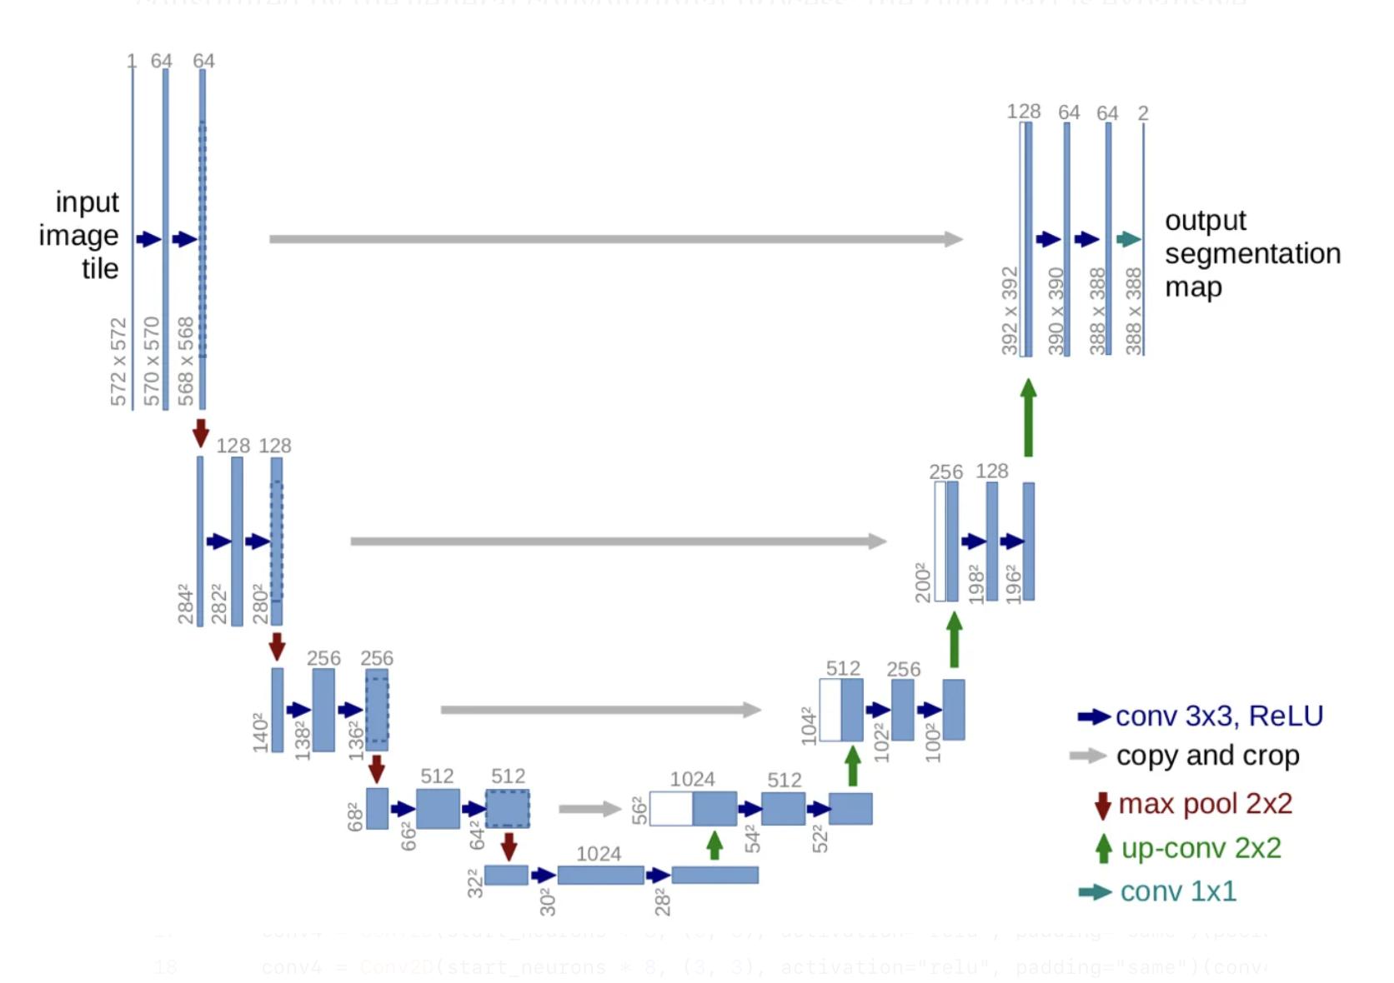
U-Net
U-Net: U-Net utilizes a contracting path (encoder) to capture contextual information and a symmetric expanding path (decoder) to localize features. The decoder path incorporates high-resolution features from the contracting path through skip connections, allowing for precise segmentation.

Slide 6
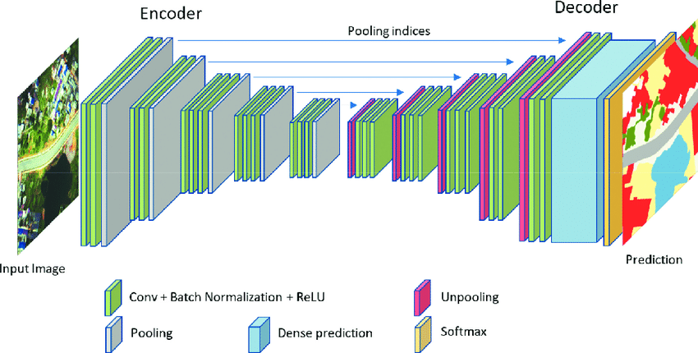
SegNet
SegNet: SegNet leverages encoders from pre-trained networks like VGG16 and employs decoders with pooling indices to achieve upsampling. It reduces the number of parameters compared to U-Net while maintaining good segmentation performance.

Slide 7
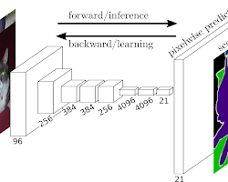
FCN
FCN (Fully Convolutional Network): FCN replaces the fully-connected layers in traditional convolutional neural networks with convolutional layers. This enables the network to process images of any size and produce pixel-wise segmentation masks.

Slide 8
Training Data
Dataset Name: MiniVess: A dataset of rodent cerebrovasculature from in vivo multiphoton fluorescence microscopy (https://www.nature.com/articles/s41597-023-02048-8)
Data Type: 3D image volumes of rodent cerebrovasculature acquired using two-photon fluorescence microscopy.
Number of Samples: Specify the number of 3D image volumes you used from the dataset (e.g., 70 or a subset).
Preprocessing: Each 3D image was converted into 100 2D image slices of .png in order to increase training samples as well as reduced training times. Additionally, Batch processing was applied which converted all pixel values within the image from a scale of 0-255 to 0 and 1 for improved performance.
This research utilized the MiniVess dataset (https://www.nature.com/articles/s41597-023-02048-8), a publicly available collection of rodent cerebrovasculature images acquired using two-photon fluorescence microscopy. A total of 70 3D image volumes were employed for training and validation. To ensure model generalizability, minimal preprocessing steps were applied, including intensity normalization.

Slide 9
Evaluation Metrics
Loss and Validation Loss: Measure how well the model's predictions fit the ground truth labels.
Mean IoU (Intersection over Union) and Validation Mean IoU: Measure the overlap between the predicted segmentation and the ground truth, providing a good overall evaluation of segmentation quality (higher values indicate better segmentation accuracy).
Accuracy and Validation Accuracy: Measure the overall proportion of correct predictions (including true positives and true negatives).
Precision and Validation Precision: Measure the proportion of true positives among the model's positive predictions (avoiding false positives).

Slide 10
Evaluation Metrics (Continued)
Recall and Validation Recall: Measure the model's ability to identify all true positive cases (correctly identifying blood vessels).
Binary Cross-Entropy and Validation Binary Cross-Entropy (if applicable): Another loss function commonly used in segmentation tasks, measuring the difference between the model's predicted probabilities and the ground truth labels (lower values indicate better performance).

Slide 11
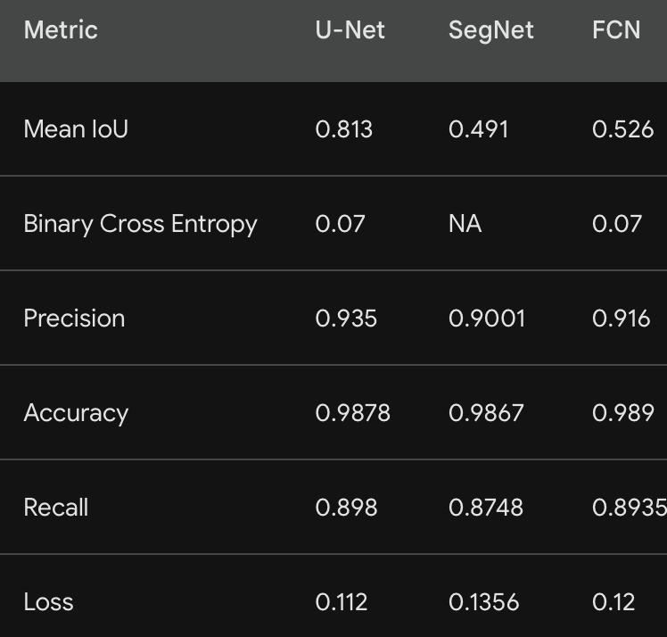
Results
U-Net achieves the highest Mean IoU (0.813) indicating superior performance in capturing object boundaries. It also boasts high accuracy (0.9878) and precision (0.935), suggesting a low false positive rate.
SegNet exhibits lower Mean IoU (0.491) compared to U-Net and FCN, suggesting less accurate segmentation. However, its recall (0.8748) is comparable to the other models, indicating it might not miss many positive cases.
FCN demonstrates a balanced performance with a Mean IoU of 0.526, accuracy of 0.989, and precision of 0.916.

Slide 12
Discussion
Overall Model Performance: Our evaluation metrics (refer to Slide 6) reveal that U-Net achieved the best performance with a Mean IoU of 0.813. This indicates U-Net's superior ability to accurately capture the boundaries of blood vessels in the MiniVess dataset. Additionally, U-Net demonstrated high accuracy (0.9878) and precision (0.935), suggesting a low false positive rate, meaning it correctly identified most blood vessels and avoided misidentifying background noise.
Observations and Challenges: During training, we observed that U-Net converged faster compared to SegNet and FCN. This might be attributed to U-Net's skip connections that help preserve spatial information during feature extraction and upsampling. While all models achieved high accuracy, a potential challenge to explore further is improving the Mean IoU scores of SegNet and FCN, possibly through hyperparameter tuning or incorporating residual connections.
Contribution to Research Objective: The successful performance of U-Net in segmenting blood vessels within the MiniVess dataset demonstrates the potential of deep learning models for this task. These findings support our research objective of evaluating the feasibility of deep learning for automated vascular segmentation in rodent brain scans.

Slide 13
Significance
Impact on Medical Imaging: The ability to accurately segment blood vessels using deep learning models has the potential to significantly impact the field of medical imaging. In neurological research, precise blood vessel segmentation can improve the efficiency and accuracy of diagnosing various conditions. For instance, it could aid in identifying abnormalities like aneurysms or blockages, allowing for earlier intervention and improved patient outcomes. Additionally, detailed information about blood vessel structure obtained through segmentation can assist in treatment planning procedures.
Future Directions and Applications: Building upon these initial findings, future research directions include:
Generalizability Testing: Evaluating the performance of U-Net on a larger and more diverse dataset of rodent brain scans. This will help assess its generalizability to different vascular structures and image variations.
Clinical Translation: Investigating the potential of applying U-Net or similar deep learning models for blood vessel segmentation in human brain MRI scans. This would require addressing challenges like the higher resolution and complexity of human brain scans compared to the MiniVess dataset.
Real-Time Applications: Exploring the potential for real-time segmentation during medical procedures. This could allow for dynamic visualization of blood vessels during surgery or other interventions, enhancing precision and safety.

Slide 14
Conclusion
Vascular segmentation plays a crucial role in analyzing brain MRI scans. This presentation explored the potential of deep learning models for automating this process.
We evaluated the performance of three deep learning models (U-Net, SegNet, and FCN) on the MiniVess dataset of rodent cerebrovasculature. U-Net achieved the best overall performance, demonstrating its ability to accurately segment blood vessels.
These findings support the potential of deep learning for vascular segmentation in rodent brain scans. Future research will focus on improving generalizability, investigating clinical applications in human scans, and exploring real-time segmentation possibilities.
Reiterating the Importance: Deep learning models offer a promising approach for automating vascular segmentation. As these models are further developed and refined, they have the potential to revolutionize medical imaging by improving diagnostic accuracy, treatment planning, and ultimately, patient outcomes.

